Slide 1

Exploring Egypt’s Real Estate Market through Nawy.com Data
Introduction:Nawy.com is a leading Egyptian real estate platform that connects users with property listings from major developers and brokers. It provides detailed information about apartments, villas, and other properties, including prices, payment plans, sizes, and finishing types.
Project Objective:The goal of this project is to scrape property data from Nawy.com and analyze it to:
Understand key property characteristics
Explore pricing trends and patterns
Identify insights into Egypt’s real estate market.

Slide 2


Step 1 – Web Scraping
Goal: Extract property listings from Nawy.com, including details on "url", "developer_name", "property_title", "property_type", "location",
"reference_no", "bedrooms", "bathrooms", "compound", "sale_type",
"finishing", "description", "price", "amenities", "delivery_in",
"property_size"
Process:
Selected Nawy.com as the data source (real estate listings platform).
Implemented web scraping techniques to collect structured data.
Stored the extracted data in a usable format (CSV).
Output:
A raw dataset of property listings ready for cleaning and analysis.

Slide 3

Step 2 – Data Understanding
Goal: Explore the dataset to assess structure, quality, and usability.
Process:
Reviewed columns and datatypes
Summarized numerical and categorical features
Identified anomalies and unusable columns
Key Findings:
Several columns had no usable data
Bedrooms & bathrooms contained outliers and invalid values
reference_no treated as identifier, not numeric
Useful categorical variables: property_type, sale_type, finishing, delivery_in
Some features need transformation to numerical format
Strong category imbalance observed
Output:
Clear understanding of dataset strengths and limitations

Slide 4
Step 3 – Data Cleaning
Goal: Prepare the dataset for accurate analysis.
Process & Actions:
Removed empty/unusable columns
Handled anomalies in bedrooms and bathrooms
Converted identifiers to correct format
Transformed features into numerical representation
Selected useful categorical variables for grouping
Noted imbalance in some categories
Output:
A clean, structured dataset ready for analysis and visualization

Slide 5
Step 5–Pre-Processing
A) Detect & Handle Duplicates
B) train_test_split
C) Detect & Handle NaNs
D) Detect & Handle Outliers
E) Encoding: (Ordinal:[OrdinalEncoder, LabelEncoder] - Nominal: [< 7 uniques(OneHotEncoding), > 7 uniques (BinaryEncoder)])
F) Imbalanced: X_train_resampled
G) Scaling: StandardScaler, MinMaxScaler, RobustScaler: X_train_resampled_scaled make it with the best syntax for my presentaion

Slide 6




step 4:Exploratory Data Analysis (EDA)&Visualization
Univariate Analysis
Bivariate Analysis
Multivariate Analysis

Slide 7
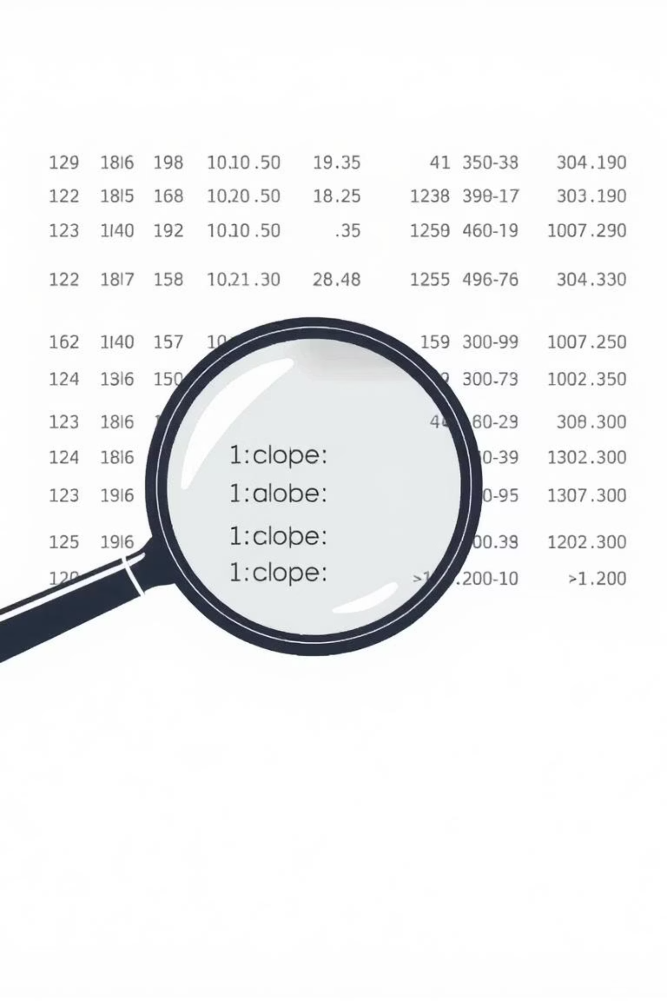
Pre-Processing Mind Map
A) Detect & Handle Duplicates
Remove or consolidate duplicate records.

Slide 8
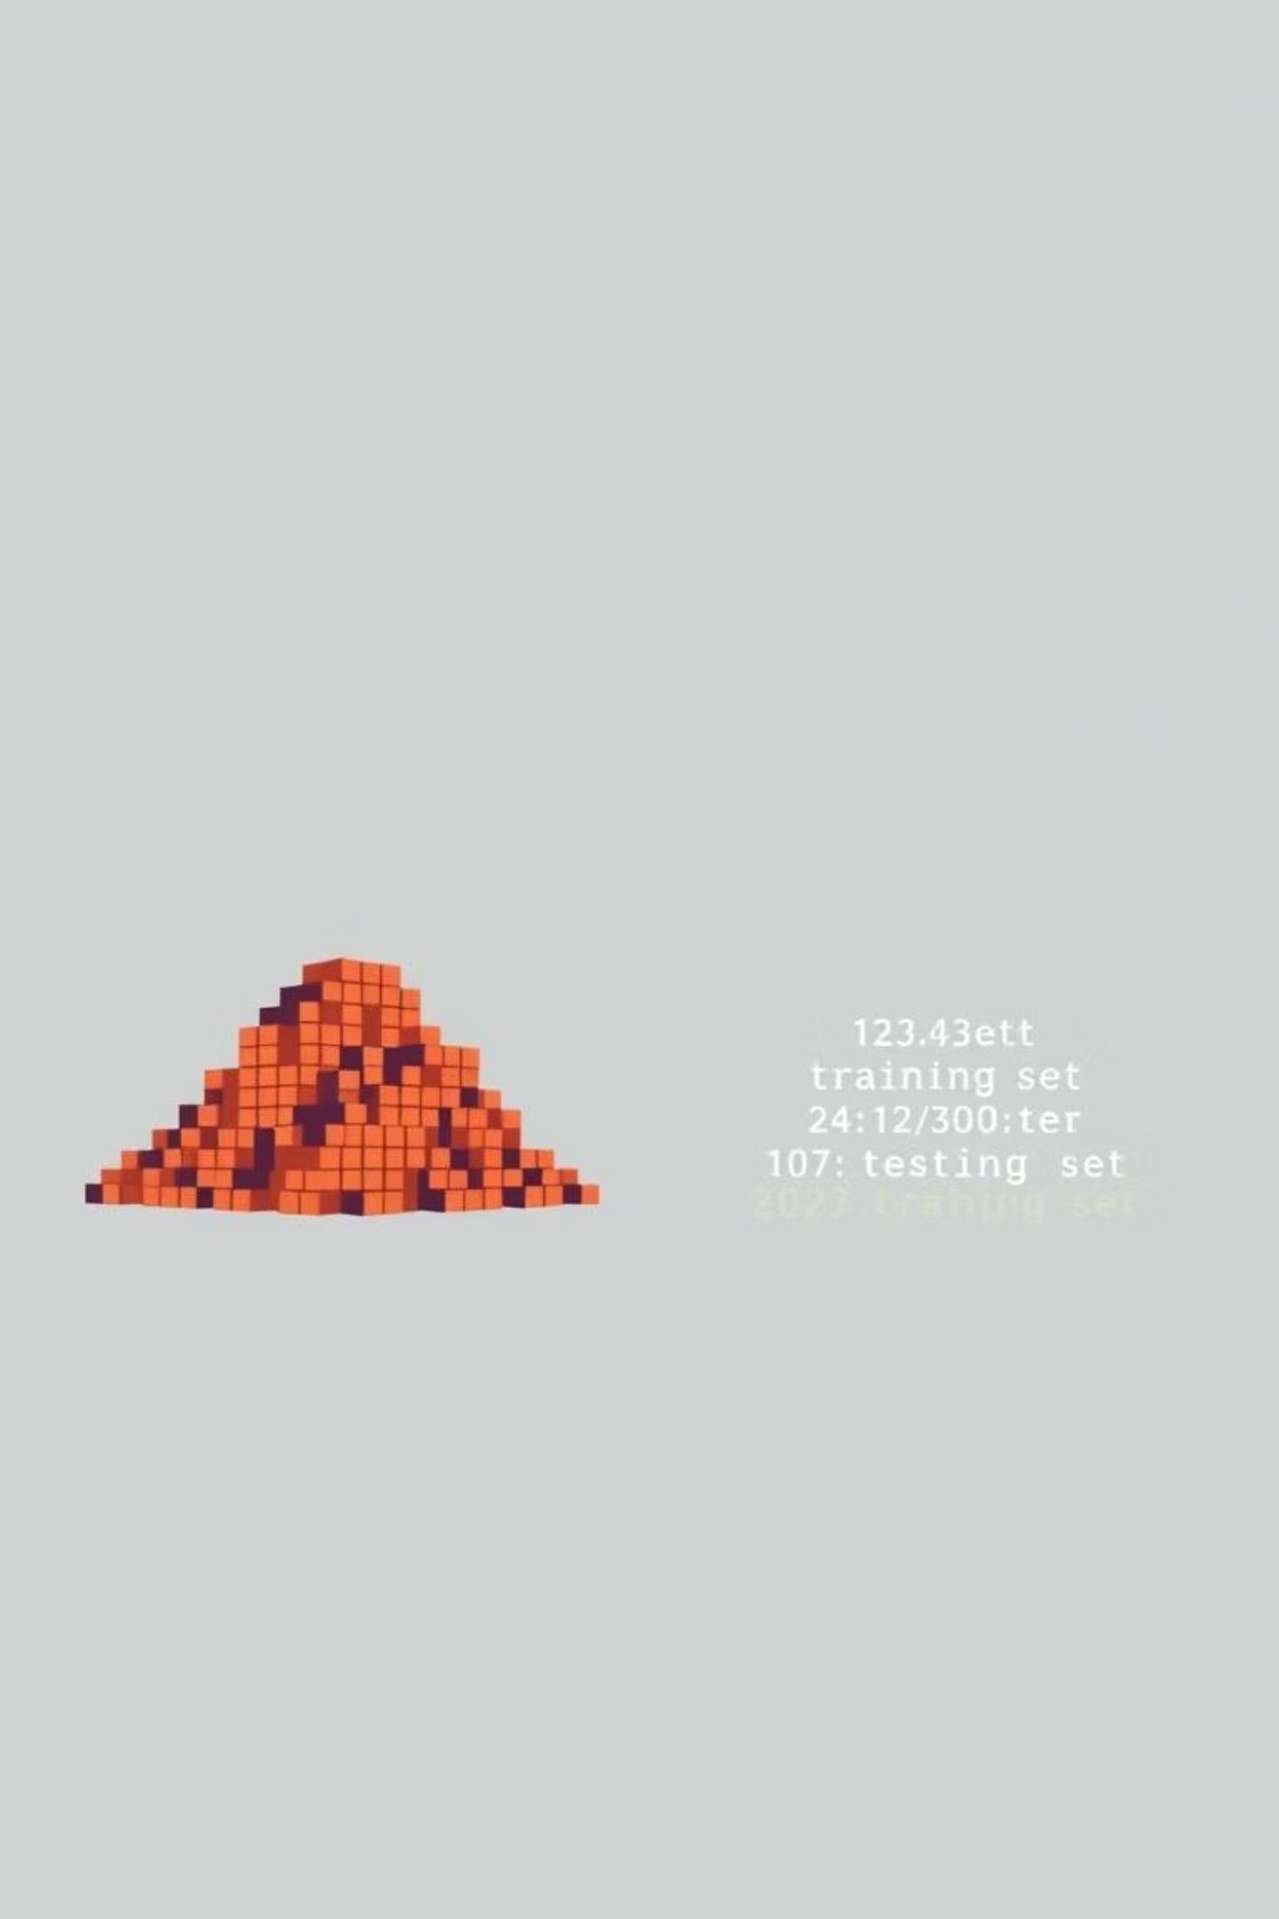
Pre-Processing Mind Map
B) Train/Test Split
Split dataset into training and testing sets.

Slide 9
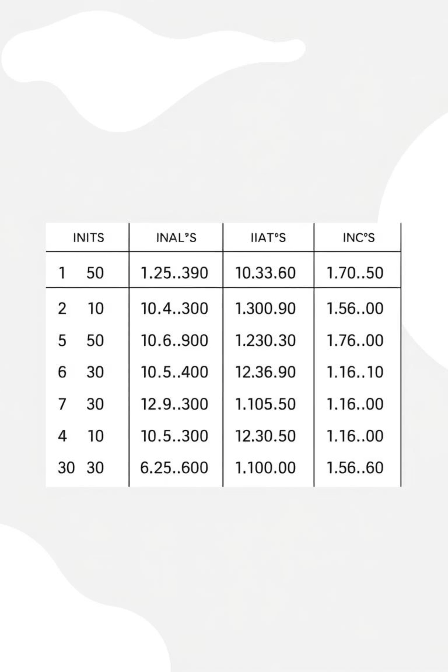
Pre-Processing Mind Map
C) Detect & Handle NaNs
Imputation (mean, median, mode)
Drop missing values

Slide 10
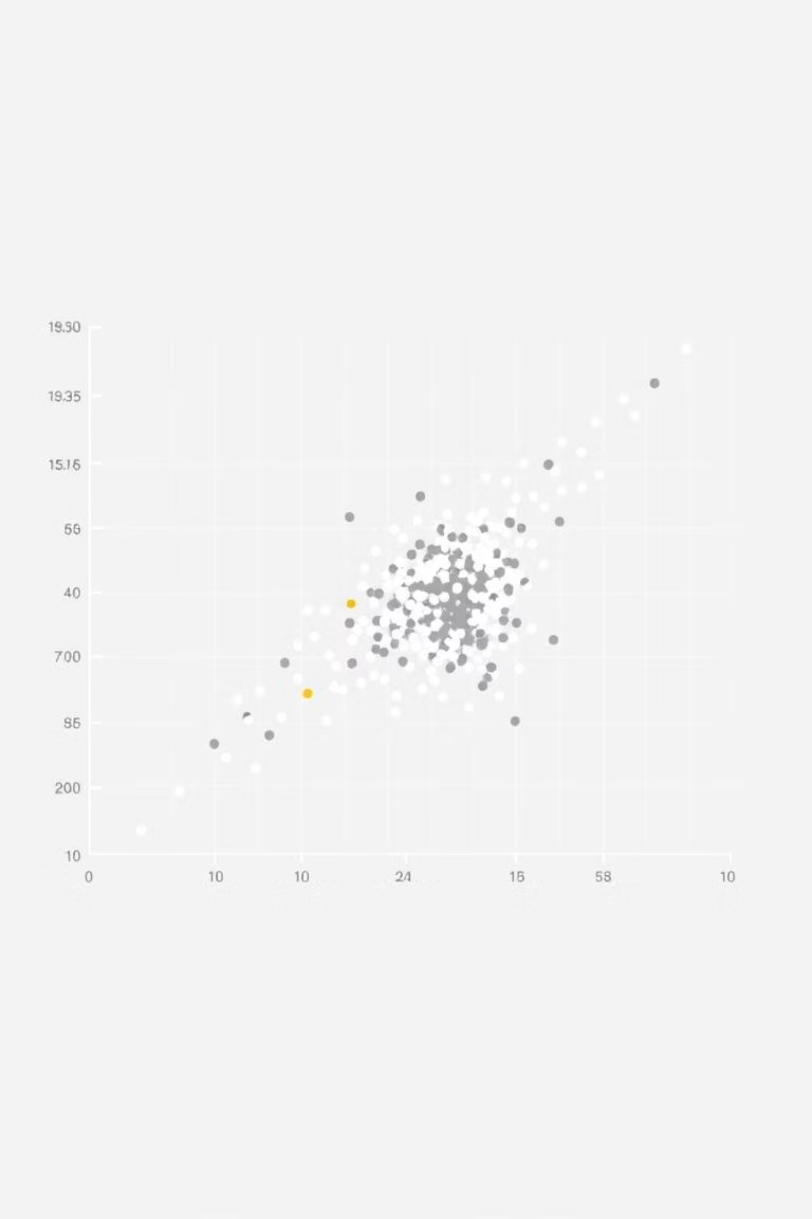
Pre-Processing Mind Map
D) Detect & Handle Outliers
IQR method, Z-score, or domain-specific thresholdsDetect & Handle Outliers

Slide 11

Pre-Processing Mind Map
E) Encoding
F) Handle Imbalanced Data
G) Feature Scaling
Ordinal Features: OrdinalEncoder, LabelEncoder
Apply scaling to resampled training data → X_train_resampled_scaled
Resample training data → X_train_resampled
Nominal Features:
< 7 unique values → OneHotEncoder
StandardScaler
≥ 7 unique values → BinaryEncoder

Slide 12
Step6:Deployment
Streamlit
Make the ML model interactive and accessible via a web app.

Slide 13

Step7:Github Rebository & Streamlit App
Rebository link
App link
https://realestateanalysis.streamlit.app/

